Slide 1
Introduction to Raspberry Pi
Rochester MakerSpace
2021

Slide 2
Class Objectives
Become familiar with Raspberry Pi hardware and software
Be aware of the range of Raspberry Pi boards
Understand how to create and run a program on an Raspberry Pi
Provide basic Python programing syntax
Understand how to control a simple circuit from an Raspberry Pi
Understand cautions when using General Purpose Input/Output pins (GPIO)
Understand proper Shutdown procedure
Provide advanced projects for continued learning
Provide list of resources for learning more

Slide 3
Class notes and code
All the class notes and code can be downloaded from GitHub:
https://github.com/RochesterMakerSpace/Raspberry-Pi-class
Pull down the green “Code” button and select “Download ZIP”

Slide 4
History
The Raspberry Pi was created in February 2012 by the Raspberry Pi Foundation to promote and teach basic computer science in schools and colleges around the UK.
The Raspberry Pi Foundation is a UK-based charity that works to put the power of computing and digital making into the hands of people all over the world. We do this so that more people are able to harness the power of computing and digital technologies for work, to solve problems that matter to them, and to express themselves creatively.
More than 1M units sold in the first year, more than 4.5M by 2014, 36M in late 2020.
Raspberry Pi 4 B went on sale in June 2019, offering faster processor and ports, as well as options for more RAM.
Raspberry Pi Pico went on sale in January 2021. It is the first microcontroller offered by the Raspberry Pi Foundation.

Slide 5
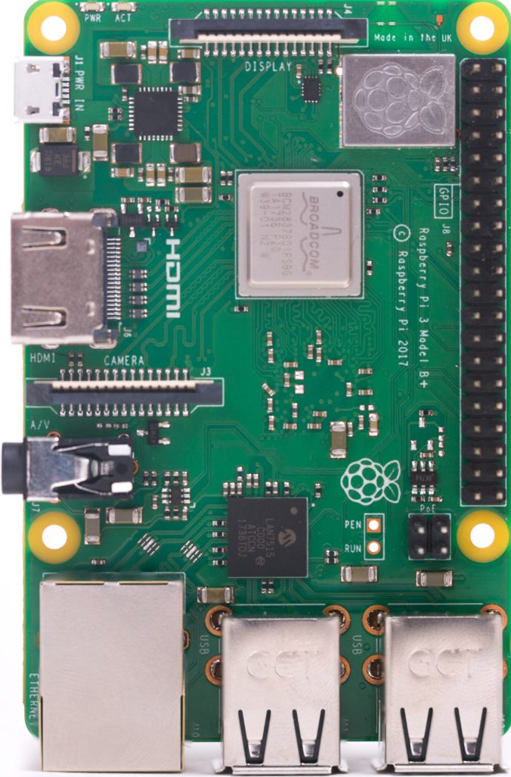
Raspberry Pi 3 B+ ($35)
Broadcom BCM2837B0, Quad Core Cortex-A53 (ARMv8) 64-bit SoC @ 1.4GHz
1GB LPDDR2 SDRAM
2.4GHz and 5GHz IEEE 802.11.b/g/n/ac wireless LAN, Bluetooth 4.2, BLE
Gigabit Ethernet over USB 2.0 (maximum throughput 300 Mbps)
Extended 40-pin GPIO header
Full-size HDMI
4 USB 2.0 ports
CSI camera port for connecting a Raspberry Pi camera
DSI display port for connecting a Raspberry Pi touchscreen display
4-pole stereo output and composite video port
Micro SD port for loading operating system and storing data
5V/2.5A DC power input (micro USB)

Slide 6
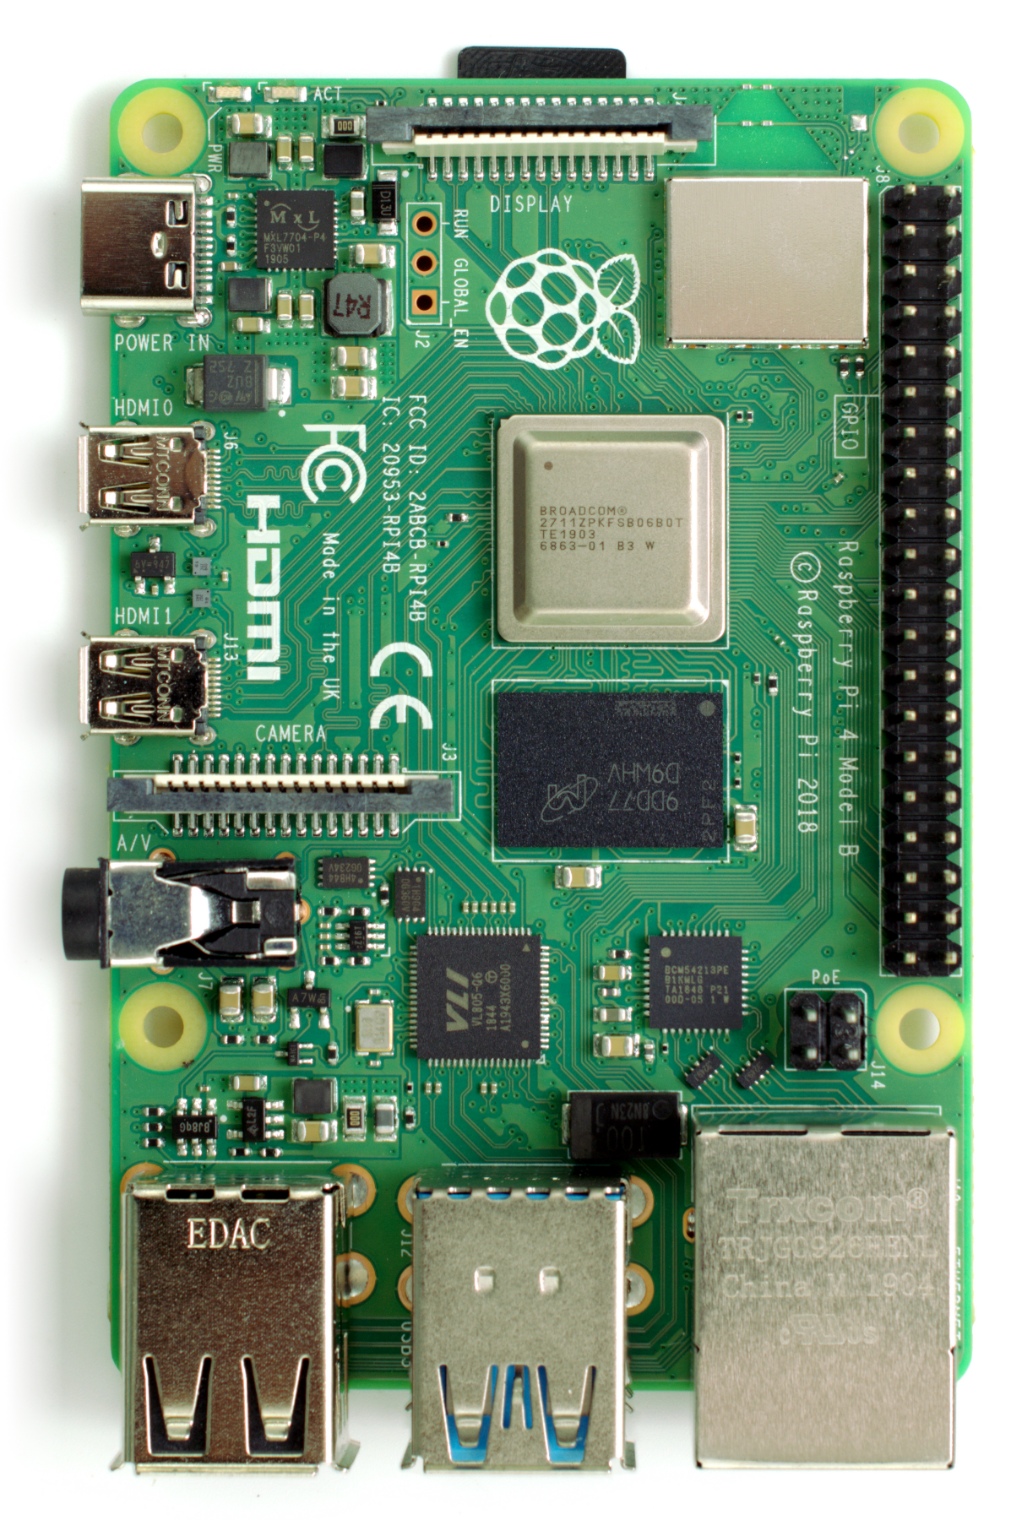
Raspberry Pi 4 B ($35–2GB, $75–8 GB)
Broadcom BCM2711, Quad core Cortex-A72 (ARM v8) 64-bit SoC @ 1.5GHz
2GB, 4GB or 8GB LPDDR4-2400 SDRAM (depending on model)
2.4 GHz and 5.0 GHz IEEE 802.11ac wireless, Bluetooth 5.0, BLE, Gigabit Ethernet
2 USB 3.0 ports; 2 USB 2.0 ports
Raspberry Pi standard 40 pin GPIO header (fully backwards compatible with previous boards)
2 × micro-HDMI ports (up to 4kp60 supported), 2-lane MIPI DSI display port
2-lane MIPI CSI camera port
4-pole stereo audio and composite video port
H.265 (4kp60 decode), H264 (1080p60 decode, 1080p30 encode), OpenGL ES 3.0 graphics
Micro-SD card slot for loading operating system and data storage
5V DC via USB-C connector (minimum 3A)
5V DC via GPIO header (minimum 3A)

Slide 7
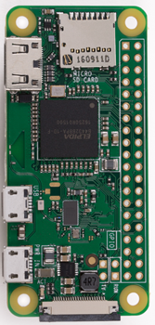
Raspberry Pi Zero W ($10)
Broadcom BCM2835,1 GHz, single-core ARM v7 CPU
512 MB RAM
IEEE 802.11n wireless (2.4 Ghz), Bluetooth 4.1, Bluetooth Low Energy (BLE)
Micro USB for power
Micro USB for OTG (On-The-Go)
Raspberry Pi standard 40 pin GPIO header (fully backwards compatible with previous boards)
Mini HDMI
2-lane MIPI CSI camera port
Micro-SD card slot for loading operating system and data storage

Slide 8

Raspberry Pi 400 ($70)
Broadcom BCM2711 quad-core Cortex-A72 (ARM v8) 64-bit SoC @ 1.8GHz
4GB LPDDR4-3200
Dual-band (2.4GHz and 5.0GHz) IEEE 802.11b/g/n/ac wireless LAN
Bluetooth 5.0, BLE
Gigabit Ethernet
2 × USB 3.0 and 1 × USB 2.0 ports
Horizontal 40-pin GPIO header
2 × micro HDMI ports (supports up to 4Kp60)
H.265 (4Kp60 decode); H.264 (1080p60 decode, 1080p30 encode)
MicroSD card slot for operating system and data storage
78- or 79-key compact keyboard (depending on regional variant)
5V DC via USB connector
Operating temperature: 0°C to +50°C ambient
Maximum dimensions 286 mm × 122 mm × 23 mm

Slide 9
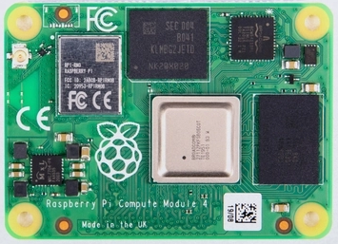
Raspberry Pi Compute Module 4 ($25)
Broadcom BCM2711 quad-core Cortex-A72 (ARM v8) 64-bit SoC @ 1.5GHz
H.265 (HEVC) (up to 4Kp60 decode), H.264 (up to 1080p60 decode, 1080p30 encode)
OpenGL ES 3.0 graphics
Options for 1GB, 2GB, 4GB or 8GB LPDDR4-3200 SDRAM (depending on variant)
Options for 0GB ("Lite"), 8GB, 16GB or 32GB eMMC Flash memory (depending on variant)
Option for fully certified radio module: 2.4 GHz, 5.0 GHz IEEE 802.11 b/g/n/ac wireless; Bluetooth 5.0, BLE; On-board electronic switch to select either external or PCB trace antenna

Slide 10
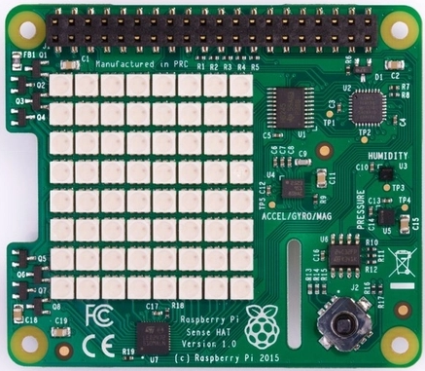
Sense HAT ($35)
The Sense HAT is an add-on board for Raspberry Pi, made especially for the Astro Pi mission – it launched to the International Space Station in December 2015 – and is now available to buy.
The Sense HAT has an 8×8 RGB LED matrix, a five-button joystick and includes the following sensors:
Gyroscope
Accelerometer
Magnetometer
Temperature
Barometric pressure
Humidity
We’ve also created a https://pythonhosted.org/sense-hat/ providing easy access to everything on the board.
On-line emulator: https://trinket.io/sense-hat

Slide 11
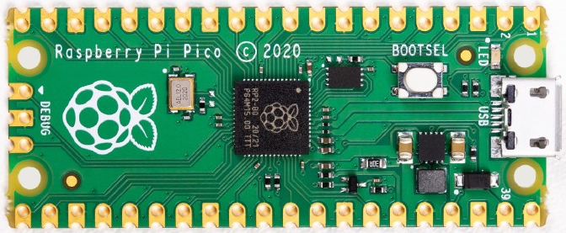
Raspberry Pi Pico ($4)
RP2040 microcontroller, Dual-core Arm Cortex-M0+, 133 Mhz
264 Kb on-chip RAM
2 Mb on-board QSPI Flash
26 multifunction GPIO pins, including 3 analog inputs
2 x UART, 2 x SPI controllers, 2 x I2C controllers, 16 PWM channels
1 x USB 1.1 controller and PHY, with host and device support
8 x Programmable I/O (PIO) state machine for custom peripheral support
Drag-and-drop programming using mass storage over USB
Temperature sensor
Accelerated integer and floating-point libraries on-chip

Slide 12
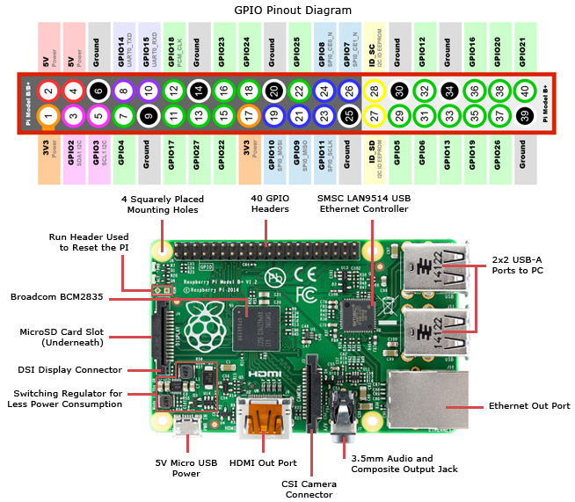
Linux with GPIO!
At 1.4MHz, quad-core and 1GB of RAM, RPi 3 B+ is a capable small Linux system
Raspberry Pi 4 offers a faster processor, two USB 3.0 ports, two (micro) HDMI ports, options of 2GB, 4GB, or 8GB of RAM
Both offer GPIO enabling the creation of different projects e.g., robots

Slide 13
Comparison vs. Arduino
Pros
More RAM + Storage
More processing power
Debug in place
Multiple, concurrent programs
Built-in HDMI and camera interfaces
Built-in WiFi and Bluetooth comms
Built-in Ethernet and 4 USB ports
Pluggable SD card to expand memory
Cons
Non-real-time OS makes real-time programming impractical
Requires some understanding of Linux
Much more configuration required
More electrical power required
No Analog (A/D) inputs
Narrow input voltage tolerance
More expensive
Bottom Line: Choose the right tool for the job

Slide 14
Remote connections
VNC (connection to user pi only)
Enable VNC in Raspberry Pi Preferences->Raspberry Pi Configuration->Interfaces
Install https://www.realvnc.com/en/connect/download/viewer/ or https://www.tightvnc.com/download.php viewer on Windows
Remote Desktop (connection to all users)
Install xrdp on Raspberry Pi: sudo apt-get install xrdp
Connect from Windows using Remote Desktop
Secure Shell
Enable SSH in Raspberry Pi Preferences->Raspberry Pi Configuration->Interfaces
Enable OpenSSH client feature on Windows: Settings->Apps->Apps & Features->Optional features
Or https://www.putty.org/ on Windows
sftp (secure ftp to transfer files)
Enable SSH on Raspberry Pi Preferences->Raspberry Pi Configuration->Interfaces
Install https://winscp.net/eng/download.php or https://filezilla-project.org/ on Windows
Transfer files:
USB flash drive
Cloud storage service

Slide 15
Resources
Raspberry Pi Foundation: https://www.raspberrypi.org/
Python Introduction: https://www.raspberrypi.org/documentation/usage/python/
Embedded Linux Wiki: www.elinux.org
Adafruit: https://www.adafruit.com/category/105?gclid=Cj0KCQiA962BBhCzARIsAIpWEL1YEmA7k-jbQbsoDKZOApe8oyufKTMf4lNfXgVyIHtExK8ghNguFY8aAmpREALw_wcB
Dronebot Workshop: https://dronebotworkshop.com/raspberry-pi-microcomputer/
Explaining Computers: https://www.explainingcomputers.com/sbc.html
Andreas Spiess: https://www.youtube.com/channel/UCu7_D0o48KbfhpEohoP7YSQ
Paul McWhorter: https://toptechboy.com/raspberry-pi-with-linux-lessons/
M Heidenreich: https://www.youtube.com/watch?v=g-tSLJ3oFzE&list=PL68Go3Wa2wAIPmz2KGwEbC7g9E6ZUgchJ

Slide 16
Python Quickstart
Thonny IDE for Python development. Python 3.7.x in right hand corner.
import statement to import modules into the program to expand functionality.
Comments: “#” or ‘’’ multiline ‘’’
Variables used to store values. Must start with a letter or “_”. Convention: use “_” between words
5 main data types: Numbers, Strings, Lists, Tuples, Dictionaries
7 arithmetic operators: + - * / % ** //. * / perform before + /. Use () for clarity.
f string: new (Python 3.6) way to format strings
Lists: define with [ ], access with list_name[0], list_name[start:end], append() to add to list
Tuples: like list but can’t change values. Use () instead of []. Can convert to list to change
Dictionary: key value pair. Use {<key1>:<value1>, <key2>:value2, etc}

Slide 17
Python Quickstart
Conditionals: if else elif. Logical operators: and or not
Looping: perform an action a set number of times: for <var> in range(0, 10):
Looping: perform repeated action but know when will end: while(<conditional>):
Functions: reuse code. def fun_name():
File I/O: write and read to file system
List module functions from >>> prompt: dir(<module> or <variable>)
List help on a module function from >>> prompt: help(module.function)
More info: https://www.youtube.com/watch?v=N4mEzFDjqtA&list=WL&index=1&t=1736s

Slide 18
GPIO Libraries
RPi.GPIO: https://sourceforge.net/p/raspberry-gpio-python/wiki/BasicUsage/
First and most popular.
gpiozero: https://gpiozero.readthedocs.io/en/v1.3.1/
Designed for ease of use.
Built on RPi.GPIO
GPIO cleanup on normal program end
pigpio: http://abyz.me.uk/rpi/pigpio/python.html
Talks to pigpio daemon
Remote manipulation of GPIO
RPIO: https://pythonhosted.org/RPIO/
Hardware PWM
TCP socket interrupts

Slide 19
Projects – Blink LED
Blink LED
Hook up LED circuit (see subsequent slide)
Programming->Thonny Python IDE
File->New
Type in code found in subsequent slide
Thonny will ask for file name and location when running for first time. Save to Maker/Documents/RaspberryPiClass/my_blink.py
This program blinks a led connected to GPIO21 (board pin 40) forever, on for 1 second and off for 1 second. It uses the gpiozero library.

Slide 20
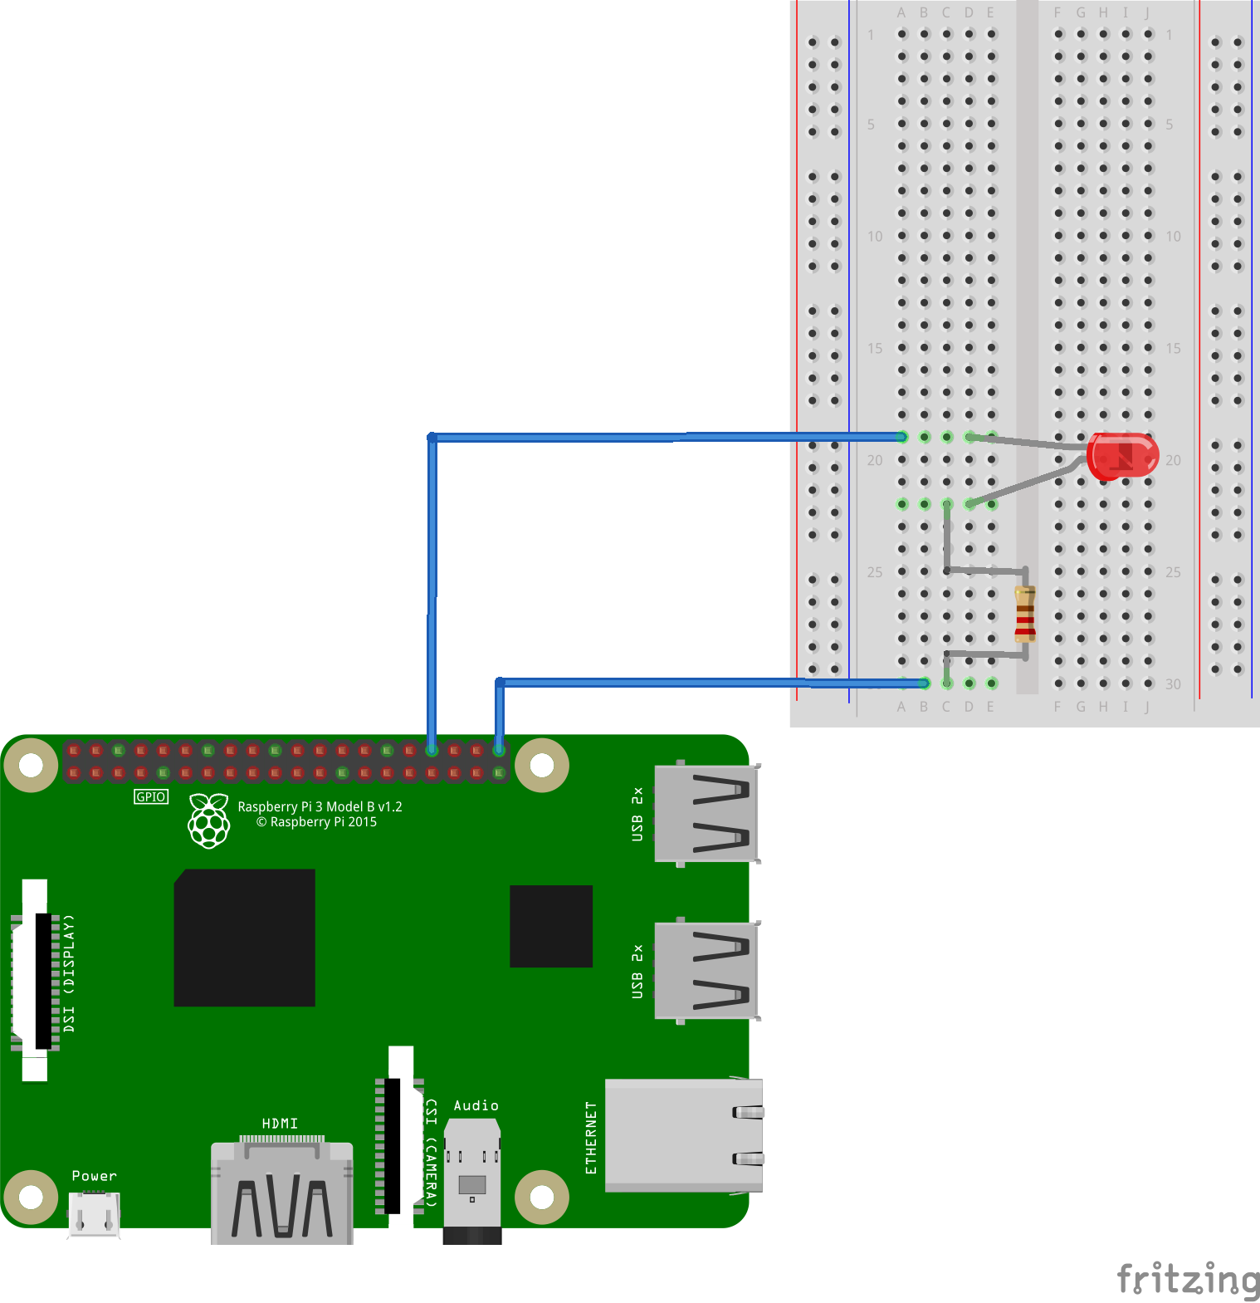

Blink LED Hookup

Slide 21
Blink LED Code
from gpiozero import LED
from time import sleep
light = LED(21)
while True:
light.on()
sleep(1)
light.off()
sleep(1)

Slide 22
Projects – Safe Blink
Safely blink LED
Load Thonny and load Maker/Documents/RaspberryPiClass/safe_blink.py
This program demonstrates GPIO cautions that should be added to each program to put the GPIO into a safe state when the program is exited. It also demonstrates the Rpi.gpio library.
Shutdown scenarios that should put the GPIO pin in a safe state:
Ctrl-C
pkill
Parent close

Slide 23
Safe Blink Code
#! /usr/bin/python3
# specify the python interpreter
import RPi.GPIO as GPIO
from time import sleep
from signal import signal, SIGTERM, SIGHUP
led_pin = 21 # use a variable for the pin number
GPIO.setwarnings(False)
GPIO.setmode(GPIO.BCM) # Use Broadcom (processor) pin numbering
# Set pin to be an output pin and set initial value to low (off)
GPIO.setup(led_pin,GPIO.OUT,initial=GPIO.LOW)
def safe_exit(signum, frame):
exit()
try:
signal(SIGTERM, safe_exit) # handle pkill
signal(SIGHUP, safe_exit) # handle parent close
while True: # Run forever
GPIO.output(led_pin, GPIO.HIGH) # Turn on
sleep(2) # Sleep for 2 seconds
GPIO.output(led_pin, GPIO.LOW) # Turn off
sleep(1) # Sleep for 1 second
# Prevent Traceback warning when using Ctrl-C to exit the program
except KeyboardInterrupt:
pass
# Cleanup if program closes due to a signal
finally:
GPIO.cleanup()

Slide 24
Projects – Fade LED
Fade LED
Load Thonny and load Maker/Documents/RaspberryPiClass/fade_led.py
This program fades a led connected to GPIO21 (board pin 40) forever. The default fade-in time is 1 sec and fade-out time is 1 second. The fade time can be adjusted using parameters fade-in-time=<sec> and fade-out-time=<sec>. It uses the gpiozero library.
Also shown is the close() function that cleans up the GPIO similar to the GPIO.cleanup() function in the RPi.GPIO libarary

Slide 25
Fade LED Code
from signal import pause
from gpiozero import PWMLED
light = PWMLED(21) # create a PWMLED object called "led"
try:
light.pulse() # blink the LED with fade-in and fade-out time
pause # pause the program
except KeyboardInterrupt: # capture CTRL-C to prevent warning
pass # no operation
finally:
light.close() # clean up the GPIO

Slide 26
Fade LED PWM

Slide 27
Cautions
Shutdown
Never just disconnect power from the Raspberry Pi
The Linux operating system continuously accesses (reads/writes) the SD card
Interrupting power in the middle of a write may corrupt the SD card
Shutdown the Raspberry Pi by:
Pi->Logout->Shutdown
Wait for green LED to stop blinking (about 10 seconds)
Remove power
GPIO
The Raspberry Pi GPIO pins work with 3.3V logic levels and are not 5V tolerant. If you apply 5V to a GPIO pin you risk permanently damaging it
Use GPIO programming cautions to avoid leaving GPIO pins in a unsafe state after the program terminates
RPi.GPIO: GPIO.Cleanup()
GPIOZERO: <module object>.close()

Slide 28
Advanced Projects – Log Fade LED
Fade LED with log algorithm
Use same circuit as Blink LED
Execute Thonny and load Maker/Documents/RaspberryPiClass/log_fade_led.py
This program will fade the brightness of a LED up and down in 10 steps. The brightness is adjusted using the PWMLED class of the gpiozero library. The PWMLED class sets the value of the LED to a number in the range of 0 to 1. This is called duty cycle with 0 being off and 1 being full on. Three algorithms are used to vary the brightness. Experiment with the algorithms and number of steps and observe the perceived brightness. A complete explanation can be found at: https://www.youtube.com/watch?v=1fKH5PU9eck&t=9s

Slide 29
Log Fade LED Code
from time import sleep
from gpiozero import PWMLED
from math import log10
light = PWMLED(21)
loop_delay = 0.2 # delay in seconds between each brightness change
# three brightness change algorithms
algorithms = ["linear", "power_2", "logarithmic"]
algorithm = algorithms[0]
steps = 10 # number of brigntness steps
fade_factor = (steps * log10(2))/(log10(steps))
led_min = 0 # minimum led brightness
led_max = 100 # maximum led brightness
led_step = 100/steps # brightness change
def brightness(level):
if algorithm == "power_2":
return pow(2, level/10)/1024
elif algorithm == "logarithmic":
return (pow(2, ((level/led_step)/fade_factor))-1)/steps
else:
# default to linear
return level/100
try:
while True: # loop forever
for level in range (led_min,led_max+1,int(led_step)): # variable x incremented from min to max by step
bright = brightness(level) # calculate new duty cycle
print("increasing:", level, bright*100) # print for debug
light.value = bright # change duty cycle to vary the brightness of LED.
sleep(loop_delay) # sleep in seconds
for level in range (led_max,led_min-1,int(-led_step)): # variable x decremented from max to min by step
bright = brightness(level) # calculate new duty cycle
print("decreasing:", level, bright*100) # print for debug
light.value = bright # change duty cycle to vary the brightness of LED.
sleep(loop_delay) # sleep in seconds
except KeyboardInterrupt:
pass
finally:
light.close()

Slide 30
Advanced Projects – Blink with Timer
Blink LED with Timer
Execute Thonny and load Maker/Documents/RaspberryPiClass/timer_blink.py
This starts by executing a function blink(). blink() starts a timer with a 1 second timeout and specifies that the same function, blink() should be called when the timer expires. The program then pauses for keyboard input. The timer does all the work in the background. When the program exits a call to sys.exit() is necessary to stop the timer, otherwise the timer will keep running and the LED will continue to blink.

Slide 31
Advanced Projects – Blink Remotely
Blink LED remotely
As user pi:
Enable Remote GPIO in Raspberry Pi Preferences->Raspberry Pi Configuration->Interfaces
Automate running pigpiod daemon at boot time: sudo systemctl enable pigpiod
Run the daemon once using systemctl: sudo systemctl start pigpiod
Or to run the daemon manually: sudo pigpiod
Install https://thonny.org/ on Windows
Install gpiozero using Thonny on Windows
Install pigpio using Thonny on Windows
Run remote_blink.py

Slide 32
Advanced Projects – Blink via Browser
Blink LED via Web Browser
Execute Thonny and load Maker/Documents/RaspberryPiClass/simple_webserver.py
Enter the PI’s IP address for the variable host name and run the program
Point browser to IP address, port 8000
Press On or Off
Reference: https://github.com/e-tinkers/simple_httpserver
This is a simple webserver and will probably not scale well. Some other options are at:
Apache and php: https://www.raspberrypi.org/documentation/remote-access/web-server/apache.md
Flask: https://projects.raspberrypi.org/en/projects/python-web-server-with-flask/1

Slide 33
Advanced Projects – Blink via Button
Blink LED via Button
Execute Thonny and load Maker/Documents/RaspberryPiClass/button_blink.py
Run button_blink.py
This program will wait for a button press. When pressed the LED will light for three seconds and then turn off.
For more information on the gpiozero Button class:
https://gpiozero.readthedocs.io/en/stable/api_input.html#
For a simple debounce technique:
https://roboticadiy.com/how-to-debounce-push-button-in-raspberry-pi-4/

Slide 34
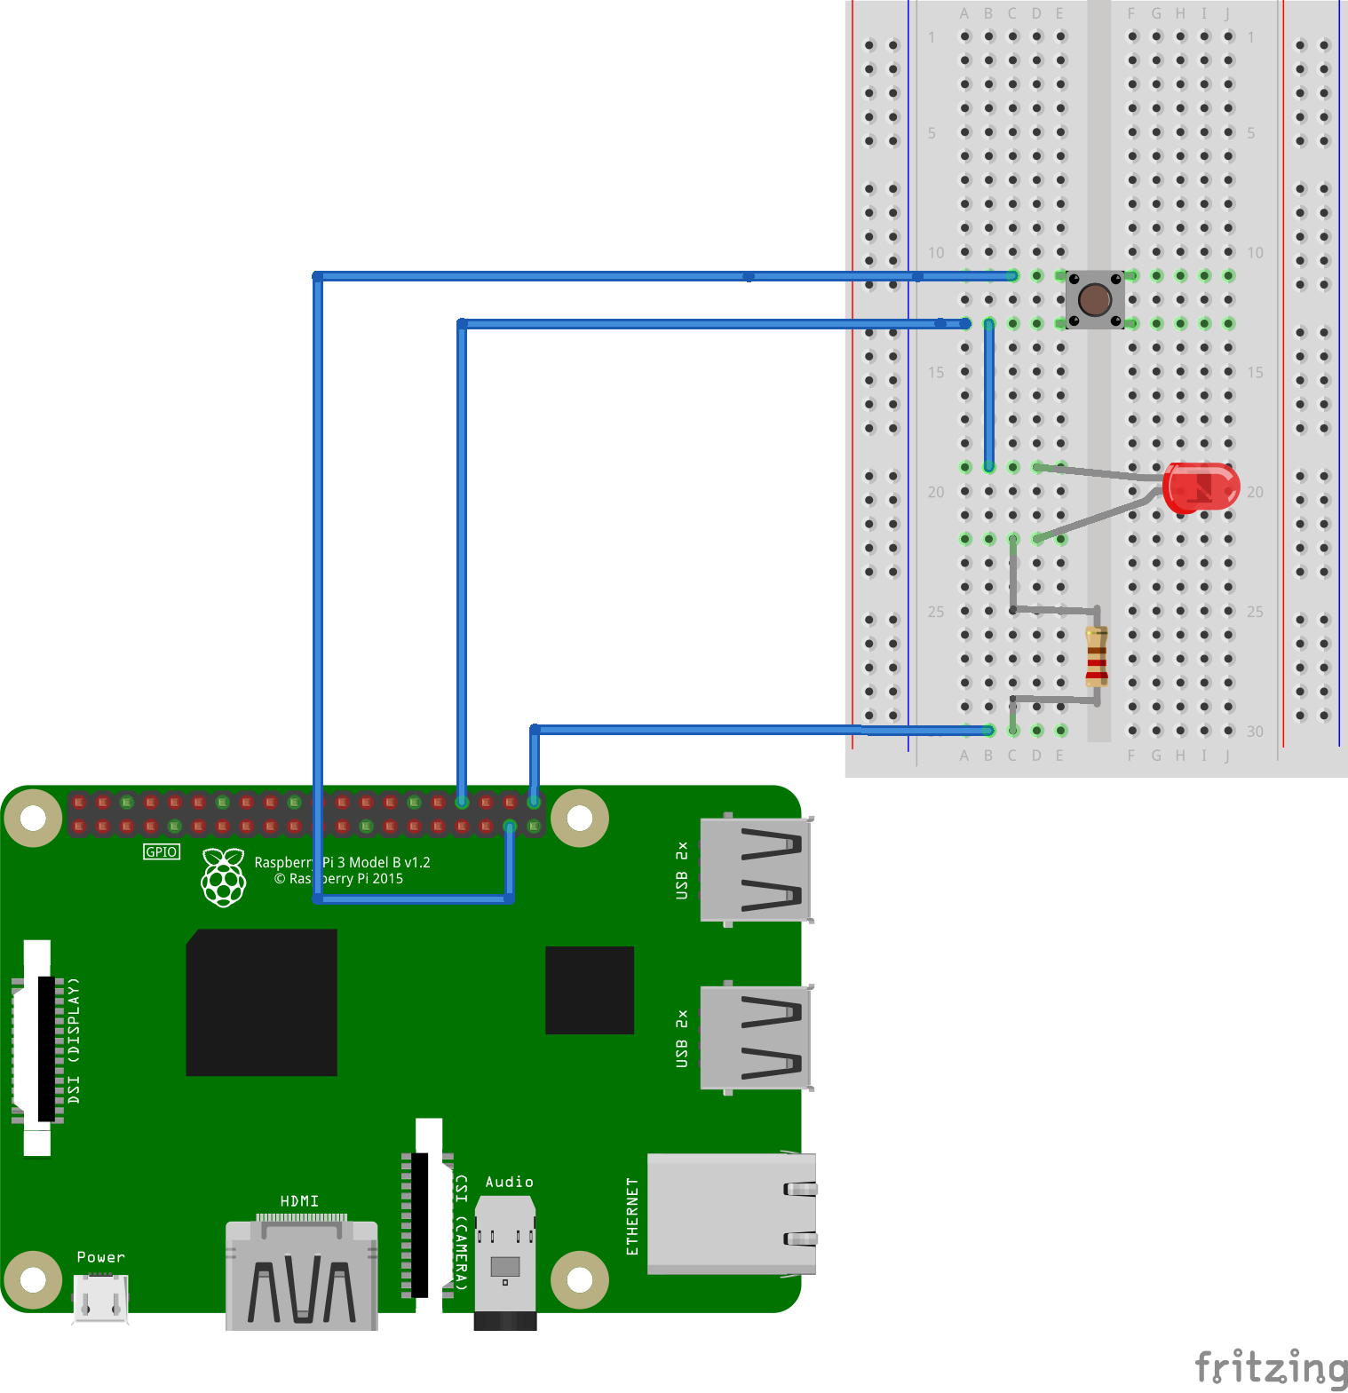

Blink LED via Button Hookup

Slide 35
Advanced Projects – Blink via Blue Dot
Blue Dot is an Android app and Python library that allows you to wirelessly control your Python projects such as a light switch, remote camera, robot, etc.
Install the Blue Dot app on your Android device from the Google Play Store: https://play.google.com/store/apps/details?id=com.stuffaboutcode.bluedot
Install Blue Dot on the Raspberry Pi: sudo pip3 install bluedot
Pair the Android device with the Raspberry Pi:
On your Android phone:
Open Settings
Select Bluetooth and make your phone “discoverable”
On your Raspberry Pi:
Click Bluetooth ‣ Turn On Bluetooth (if it’s off)
Click Bluetooth ‣ Make Discoverable
Click Bluetooth ‣ Add Device
Your phone will appear in the list, select it and click Pair
On your Android phone and Raspberry Pi.
Confirm the pairing code matches
Click OK
On the Raspberry Pi execute Thonny and load and execute the demo program blue_dot_led.py
On the Android device open the Blue Dot app and connect to the paired device. Press the dot to blink the led.

Slide 36
Handy Linux commands
Get ip address of Pi: hostname –I
Change permission of a file to executable: chmod 755 <file>
Get the Raspberry Pi OS version: cat /etc/os-release
Get Raspberry Pi GPIO pinout: pinout
Update Raspberry Pi OS
Update system’s package list: sudo apt-get update
Upgrade installed packages: sudo apt-get upgrade
Command line configuration: sudo raspi-config
Check disk usage: df –h
Check GPIO status: gpio readall (raspi-gpio get on Raspberry Pi 4)

Slide 37
Install Raspberry Pi OS
For full instructions go to: https://www.raspberrypi.org/documentation/installation/installing-images/
Download Raspberry Pi Imager and install it: https://www.raspberrypi.org/software/
Run Imager and Choose OS and SD Card to write to (make sure you are choosing the correct driver letter for the SD Card.
Write, All existing data on ‘SDHC Card’ will be erased. Yes to continue
After a few minutes a message will indicate that the OS is written to the SD card
Remove the SD card from the PC and install into the Raspberry Pi.
Power up the Raspberry Pi and go through the welcome setup screens
The default user is ‘pi’ and password is ‘raspberry’. It is recommend to change the password
Setup your wifi network
The OS will be updated to latest

